Slide 1
SOCIAL NETWORK (PHP Project)
Submitted by-
ANURAG KUMAR SINGH (RA1511003030394)

Slide 2
INTRODUCTION
Social Network is a web application which is implanted in PHP platform. In this project, user can easily interact with another user. User can do multiple things in this like-Resister to the website, Login to the website, Update profile picture, Upload details through settings, Upload image, videos, YouTube links on the wall to share with others, Users can like and comment to the posts, User can set events, User can create different page, User can make friends, User can message to another user.
This Responsive Online PHP site is easy to operate and understand by users. It is built on powerful open source language PHP and MySQL that allows to manage different operations. This software program is built to manage and computerize traditional database.

Slide 3
ABSTRACT
Social Network is a web application which is implanted in PHP platform.
In this project, user can easily interact with another user.
User can do multiple things in this like-
Resister to the website
Login to the website
Update profile picture
Upload details through settings
Upload image, videos, YouTube links on the wall to share with others
Users can like and comment to the posts
User can set events
User can create different pages
User can make friends
User can message to another user
This Responsive Online PHP site is easy to operate and understand by users.
It is built on powerful open source language PHP and MySQL that allows to manage different operations.
This software program is built to manage and computerize traditional database.

Slide 4
HARDWARE REQUIREMENTS
Computer processor(Pentium4 min)
Hard Disk(50 GB min)
RAM(512 MB min)

Slide 5
SOFTWARE REQUIREMENTS
Notepad++(IDE)
XAMP server
Tomcat Apache
MySQL
PhpMyAdmin
Php language
Web browser

Slide 6
SYSTEM FACILITIES
Home page-
This page is the login page where user have to enter email and password to access their account and if they don’t have they can register.
Profile page-
From here they can use the benefits of the function of the social network.
They can chat, post. Create pages, events etc.

Slide 7
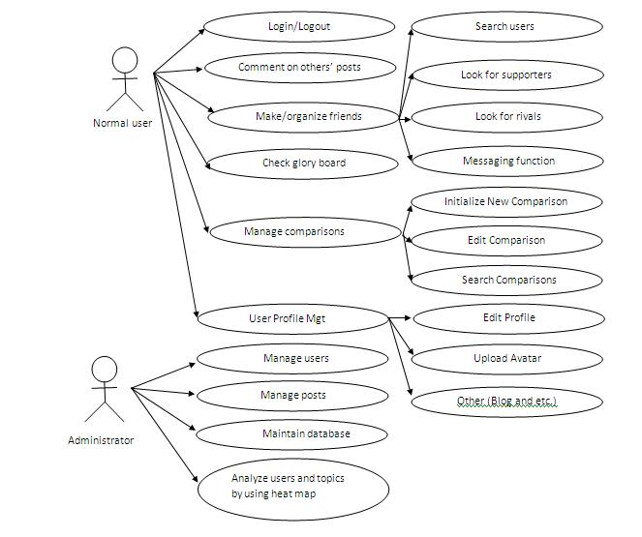
System Designs

Slide 8
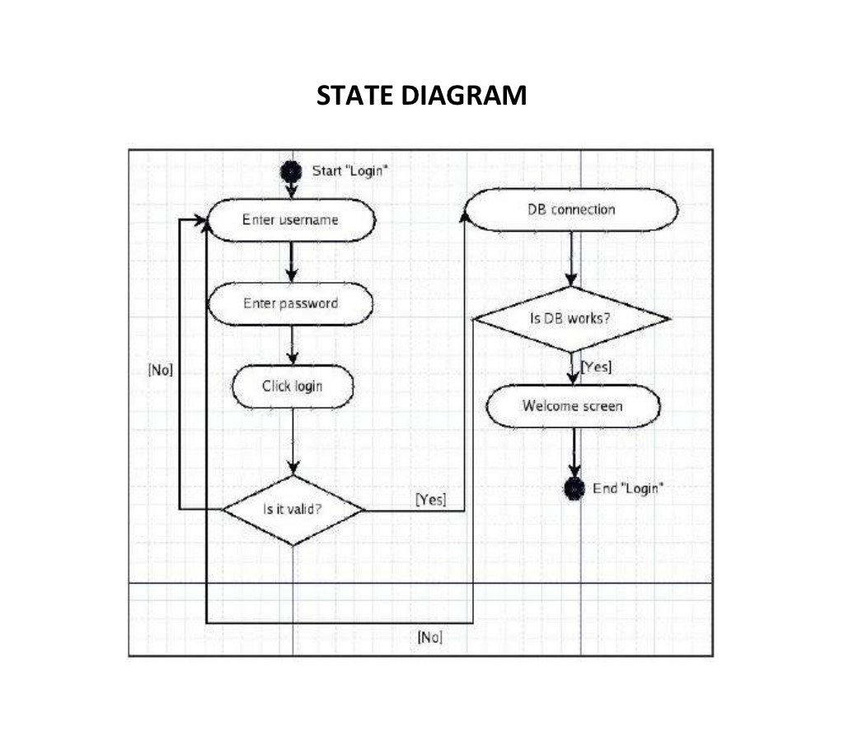

Slide 9
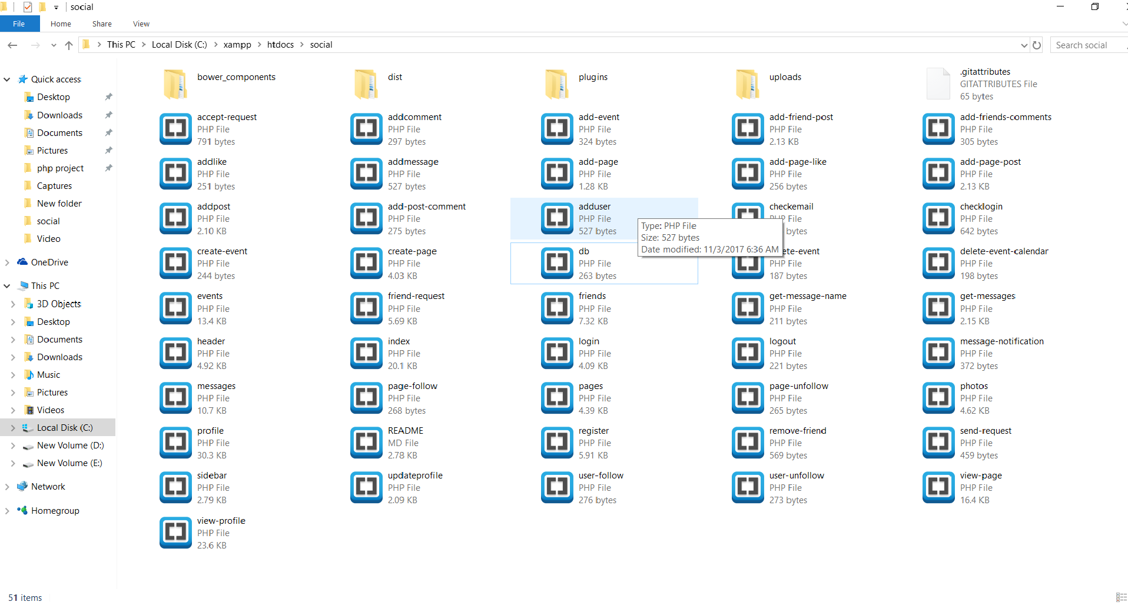
Screenshot

Slide 10
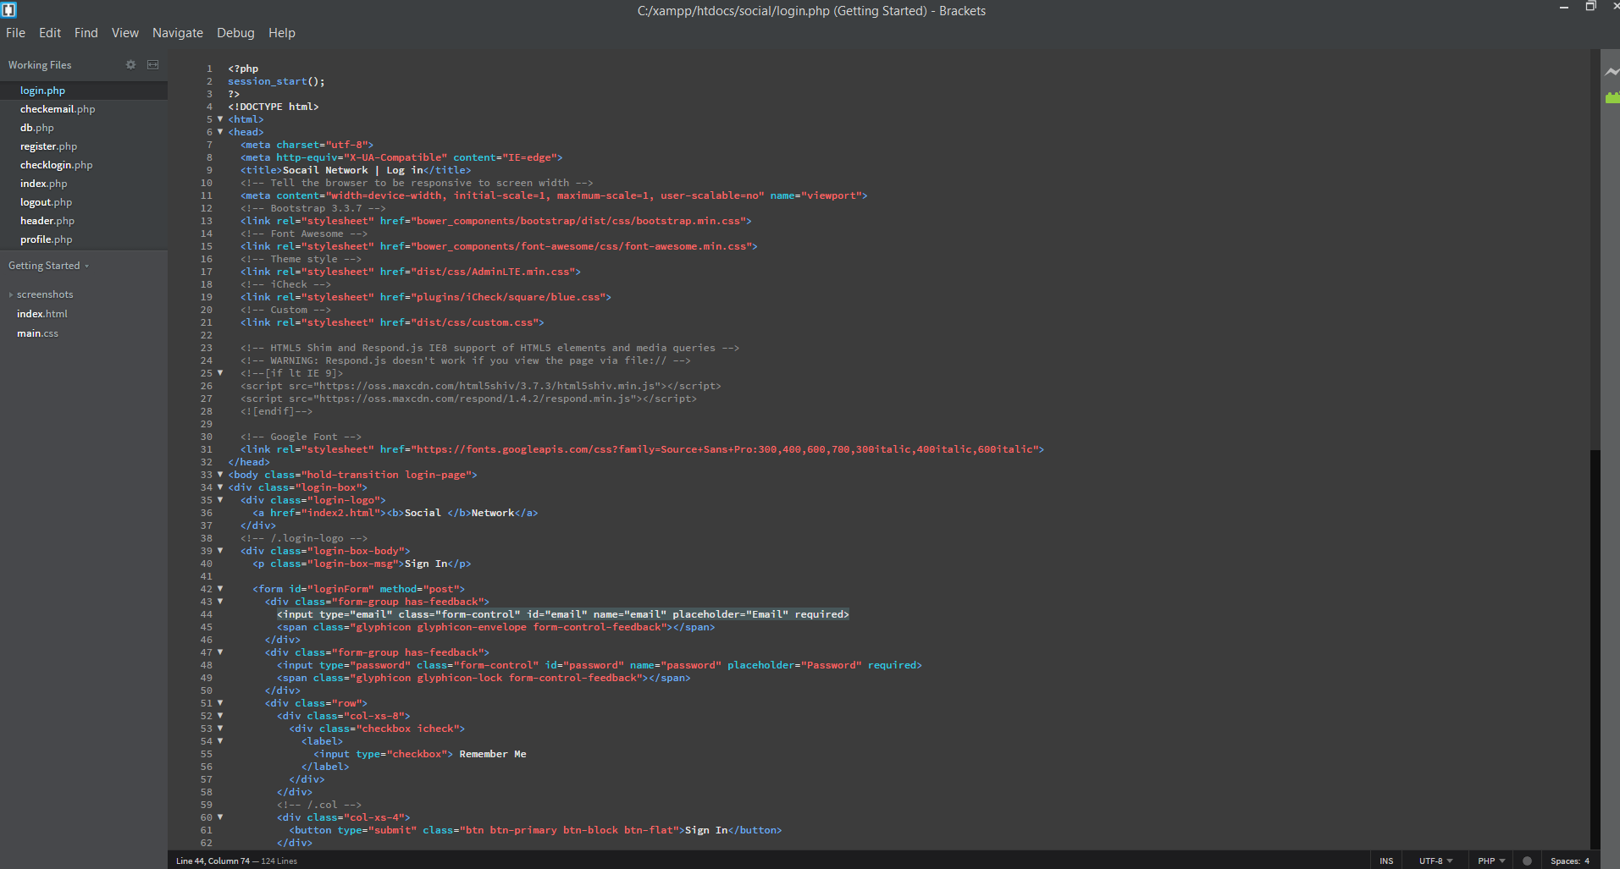

Slide 11
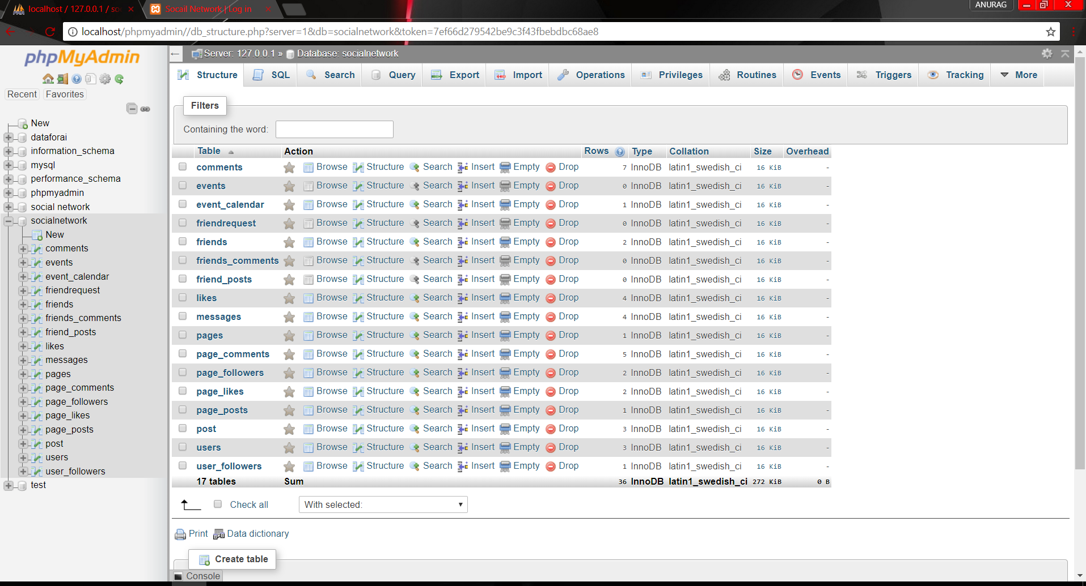

Slide 12
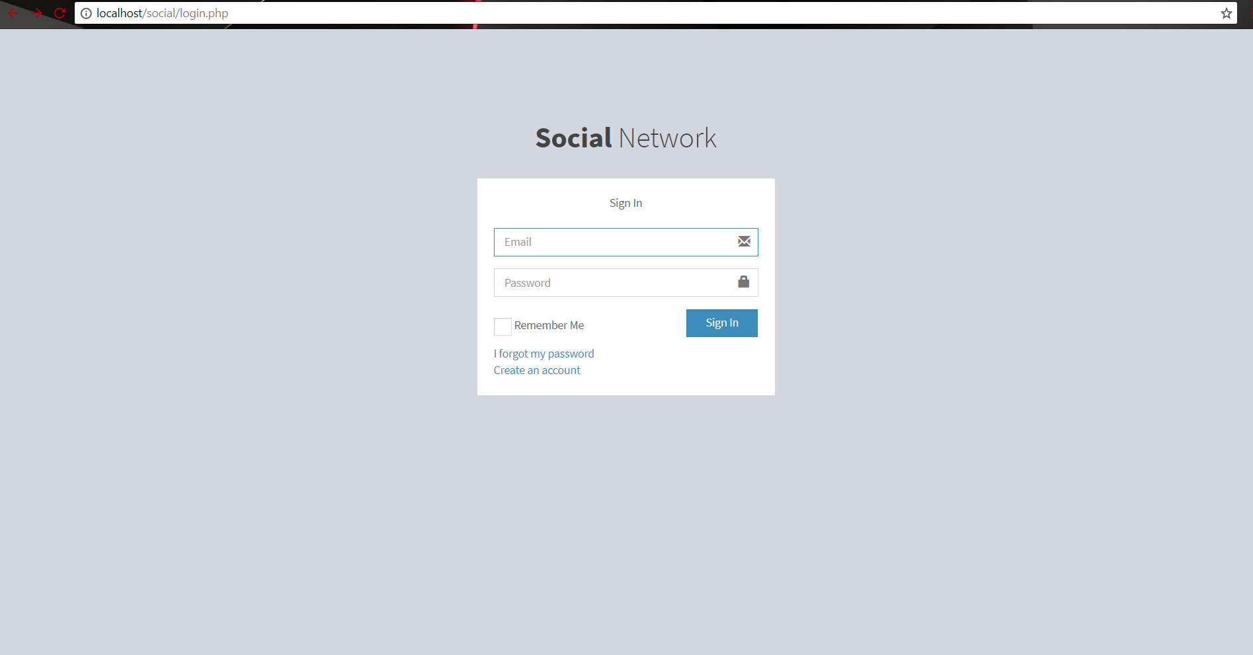

Slide 13
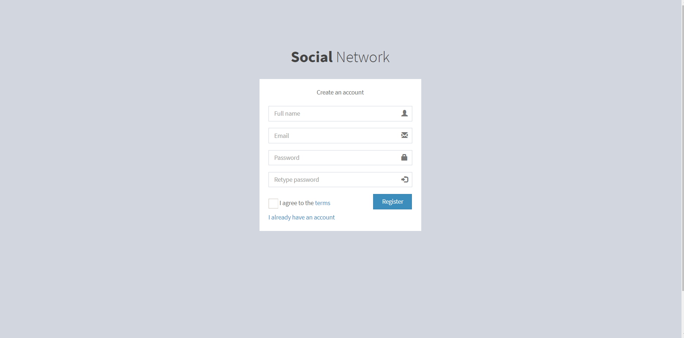

Slide 14
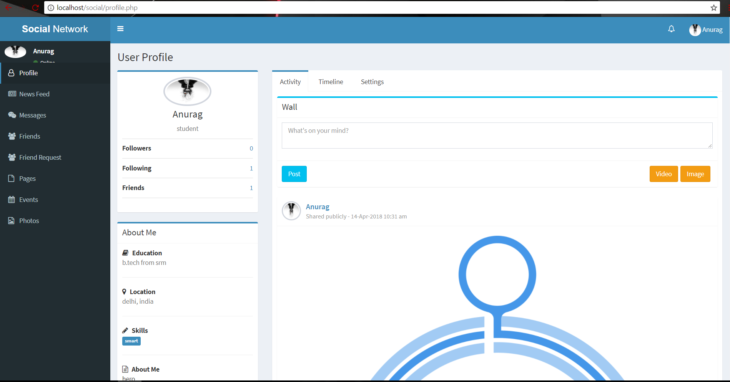

Slide 15
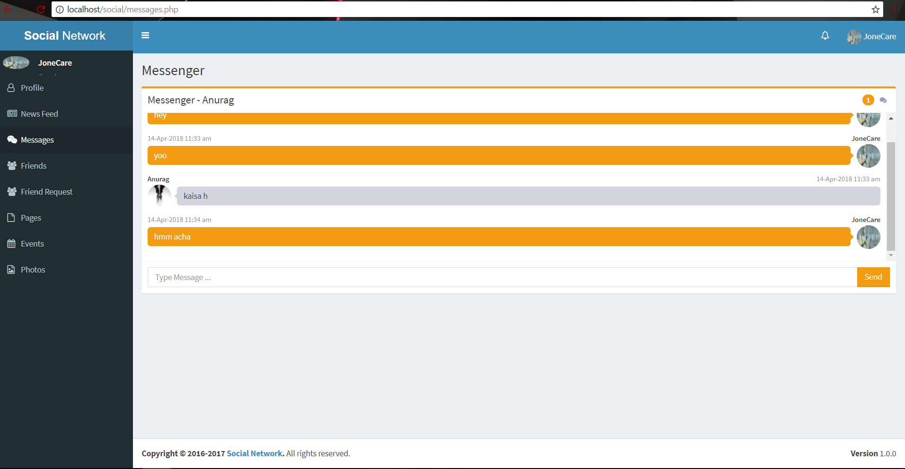

Slide 16
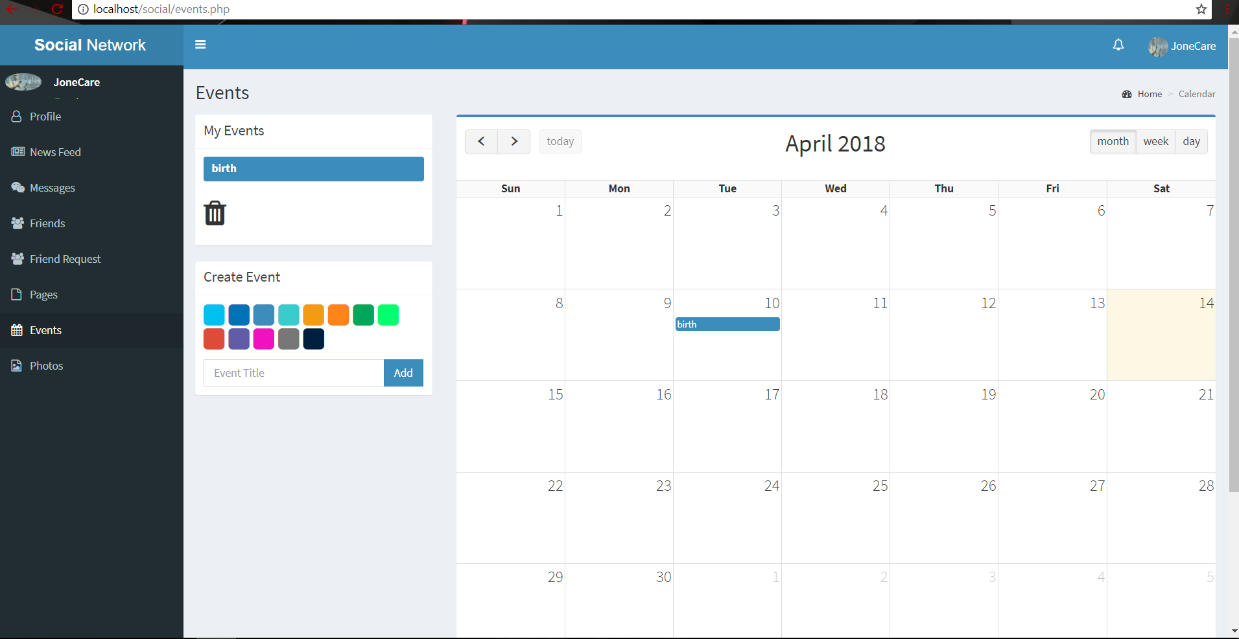

Slide 17
Conclusion
Technology has made significant progress over the years to provide consumers a better platform to interact with each other. People need platform where they can share different things with their friends and family. Social Network is a platform where users interact with each other. On this platform people make friends and can talk with them even they have big distances between them.
They can share their feelings without taking any thought about security. Social networking is a tool that can both help and harm. Whether it is used for business, school, research, or for relationship building, social networks offer many new and exciting opportunities. However, the unsuspecting user can quickly be led down a potentially dangerous path. I give social networking neither the green light nor the red light but rather the yellow light: proceed with caution.

Slide 18
Thank You

